Slide 1

Types of Charts – Overview, Analysis & Uses

Slide 2
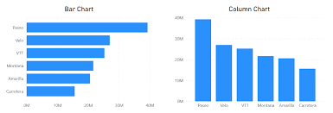
1. Bar Chart
Description:
A bar chart uses rectangular bars of equal width but varying height or length to represent data.
Analysis:
Compares quantities across categories
Longer bar = higher value
Easy to identify largest and smallest groups

Slide 3
2. Column Chart
Description:
Similar to a bar chart but bars are vertical.
Analysis:
Shows changes over time
Highlights rise and fall in values

Slide 4
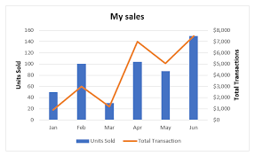
3. Line Chart
Description:
Uses points connected by lines to show trends over time.
Analysis:
Shows upward or downward trends
Helps predict future values
Identifies patterns (increase/decrease)

Slide 5
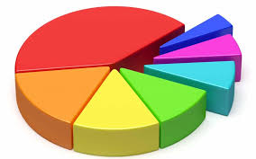
4. Pie Chart
Description:
A circular chart divided into slices representing parts of a whole.
Analysis:
Shows percentage distribution
Slices indicate relative proportion
Larger slice = larger share

Slide 6
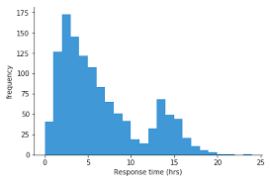
5. Histogram
Description:
Similar to a bar chart but used for continuous data and intervals (bins).
Analysis:
Shows frequency distribution
Identifies shape (normal, skewed)
Useful for studying spread of data

Slide 7
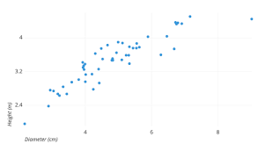
6. Scatter Plot
Description:
Displays data as individual points on a coordinate plane.
Analysis:
Shows relationship between two variables
Identifies correlation (positive, negative, none)
Reveals clusters or outliers

Slide 8
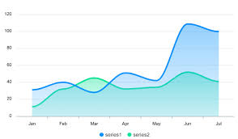
7. Area Chart
Description:
Similar to a line chart but area under the line is filled with color.
Analysis:
Shows cumulative totals
Highlights volume and changes over time

Slide 9
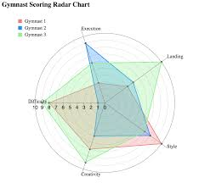
8. Radar Chart(Spider Chart)
Description:
Displays multiple variables on a circular graph with several axes.
Analysis:
Compares strengths and weaknesses
Shows performance across many attributes

Slide 10
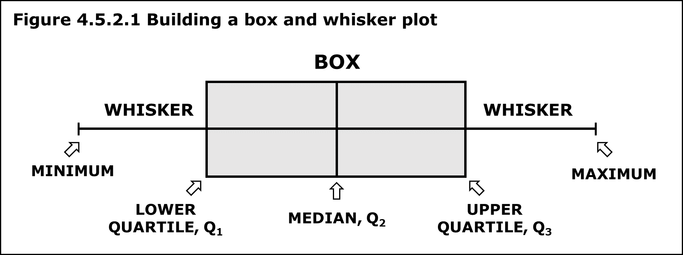
9. Box & Whisker Plot
Description:
Shows distribution of data using median, quartiles, and extremes.
Analysis:
Identifies outliers
Shows data spread and skewness
Useful for statistical comparison

Slide 11
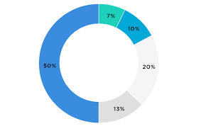
10. Donut Chart
Description:
A variation of the pie chart with a hollow center.
Analysis:
Shows proportion of categories
Center can be used for labels or totals

Slide 12
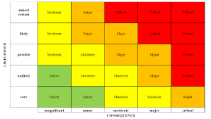
11. Heat Map
Description:
Uses colors to represent values in a data matrix.
Analysis:
Highlights intensity or magnitude
Quickly shows high/low regions
Good for large datasets

